Slide 1

Shri Vaishnav Vidyapeeth Vishwaviyalaya
Shri Vaiishnav Vidyapeeth Vishwavidyalaya
Department of Information Technology
Session january-June2022
PRESENTATION ON AUTOMATED WHEELCHAIR
Rishika Jain [19100BTIT6604]
Sabiha Bee [19100BTIT6606]
Shraddha Vishwakarma [19100BTIT6613]
Shristi Sisodiya [19100BTIT6615]

Slide 2
INTRODUCTION
The aim of this project is to use wheelchair automatically for moving forward, backward, Left & Right. The overall framework of this project is to restore autonomy to severely Disabled people by helping them use independently a power wheelchair.
A wheelchair is an electric wheelchair fitted with acceleration sensors, obstacle sensor and computer to help less able drivers achieve some independent mobility. By just tilting acceleration sensor wheelchair can be moved in four directions.
The obstacle sensor can help the rider control the wheelchair by taking over some of the responsibility for steering and avoiding objects until he or she is able to handle the job. The amount of work that the rider chooses to do and how much control is taken by the chair is decided by the rider and his or her care. Obstacle in the way can be determined by wheelchair and wheelchair will stop automatically.

Slide 3
Application of Automatic Wheelchair:
Hostels
Health care centers
Old age home
Physically handicapped individuals
In industries as robot to carry goods.
Automatic gaming toys.
Communication
Control of Mechanical systems
Sports
Objectives of Automated Wheelchair
Automated wheelchairs that are equipped with sensors & data processing unit are termed as Smart Wheelchair. Our goal is to design and develop a system that allows the user to robustly interact with the wheelchair at different levels of the control and sensing

Slide 4
Components
Aurdino UNO
Keypad
Ultrasonic Sensors
Buzzer
Motor Driver L293D
Motors
Battery Of 12V
Chassis
Bluetooth Module(L293d)
Chair

Slide 5
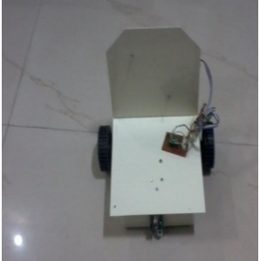
Snapshot of Wheelchair

